Slide 1
3rd Health Programme 2014-2020
Overview of projects and actions, covering digital health, chronic and rare diseases, funded under the EU Health Programme
Sarajevo, 22 October 2019
Marc VANDENBROECK
Scientific Project Officer European Commission Consumers, Health, Agriculture and Food Executive Agency (Chafea) Health and Food Safety Unit

Slide 2
Chafea
Consumers, Health, Agriculture and Food Executive Agency

Slide 3
Who we are, what we do
History, Objectives

Slide 4
WHO WE ARE?

Slide 5
WHAT WE DO?
Our mission is to provide high quality support to our beneficiaries and stakeholders, and to ensure that the actions funded by the four programmes deliver results and provide the Commission with valuable input for its policy tasks.
Chafea is committed to the Public service principles for EU civil servants.

Slide 6
DG SANTE
Chafea
Information workshops, Guidelines, etc.
Policy Priorities
Publication of Calls
External Evaluation (Projects, JA, etc.)
Health Programme(s)
Evaluation
EC internal evaluation (Tenders)
Yearly Workplan
Negotiation/
Contracting
External Evaluation
Monitoring/
Payments
Audits
Policy Development
Dissemination
Publications, webpages, etc.
Summary reports, meetings
MS Contacts
Archiving

Slide 7
3rd Health Programme

Slide 8
Overview
Chronic diseases
Rare diseases
Digital health

Slide 9
OVERVIEW

Slide 10
Objective 1: Promoting health, prevent diseases, and foster supportive environments for healthy lifestyles
Budget allocation by objective 2014 - 2018

Slide 11
Objective 1: Main activities per thematic priorities
EU Funding:
€ 96 m
Chrodis and Chrodis Plus – Joint Actions on chronic diseases € 9 m
Action on migrants' health € 15,3 m (2015-2018)
JANPA – Joint Action on Nutrition and Physical Activity € 1.2 m
iPPAC – Joint Action on Cancer € 4.5 m JARC – Joint Action on rare cancers €1.5
Other activities on tobacco control including operating grants to NGOs € 5 m
ECIBC – European Commission Initiative on Breast Cancer € 1.5 m European Cancer League operating grant € 1,6 m
Activities on reducing alcohol related harm € 4.3 m
JATC – Joint Action on Tobacco Control € 1.95 m
Data 2014 - 2018

Slide 12
Objective 2: Main activities per thematic priorities
EU Funding:
€ 29 million
EU JAV: Vaccination € 3.5 million
EMERGE: Efficient response to highly dangerous and emerging pathogens
€ 3.5 million
Top table exercises, workshops and events to support the implementation of the Decision 1082/2013/EU on serious cross-border threats to health € 1.4 m
INTEGRATE: JA on HIV, viral hepatitis, tubercolosis and sexually transmitted infections € 2 million
Conferences organised by the European Commission
EU Healthy Gateways Preparedness and actions at points of entry: air, maritime and ground crossing € 3 million
2019 Global Vaccination Summit 2015 Ebola epidemic in West Africa
SHARP: Strengthened International Health Regulations and Preparedness in the EU € 7.9 million
Data 2014 - 2018

Slide 13
Objective 3: Main activities per thematic priorities
EU Funding:
€ 75 m
eHACTION – Joint Action to support eHealth Network € 2.7 m
EU JAMS – Joint Action on Market Surveillance of medical devices
€ 0.8 m
EUNETHTA- Joint action on Health Technology Assessment € 11.9 m
SEPEN – Action on health workforce € 0.8 m
State of Health in the EU / PARIS € 4,8 m
Data 2014 - 2018

Slide 14
Objective 4: Main activities per thematic priorities
EU Funding:
€ 62 m
EURORDIS – European Organisation for Rare Diseases Association € 5 m
VISTART – Joint Action on vigilance and inspection for safety of transfusion assisted reproduction and transplantation € 2.3 m
ERN- European Reference Networks (ERNs) Coordination of ERNs € 26 m Other activities € 3 m
GAPP – Joint Action on facilitatinG the Autorisation of Preparation Process for blood and tissues and cells € 1.2 m
Cooperation program with CoE/EDQM on specific matters related the improvement of safety and quality of blood components and tissues and cells for human application and dissemination of best practices € 0.5 m
JAMRAI – Joint Action on antimicrobial resistance and health care associated infections € 4 m
Data 2014 - 2018

Slide 15
CHRONIC DISEASES

Slide 16
Chronic diseases
JAs
CHRODIS (2013)
CHRODIS + (2016)
PJs
EFFICHRONIC (2016)
SEFAC (2016)

Slide 17
Frailty
JAs
ADVANTAGE (2015)
PJs
FRAILCLINIC (2013)
FRAILTOOLS (2014)
APPCARE (2014)
SUNFRAIL (2014)

Slide 18
Healty ageing / Best practices
PJs
EUPAP (2019)
YOUNG 50 (2019)

Slide 19
Chrodis and Chrodis Plus Joint Actions on chronic diseases
€ 9 m

Slide 20
Chronic diseases

Slide 21
Chronic diseases

Slide 22
Chronic diseases

Slide 23
RARE DISEASES

Slide 24
Rare diseases
ERN- European Reference Networks (ERNs)
Coordination of ERNs
€ 26 m
Other activities
€ 3 m
EURORDIS – European Organisation for Rare Diseases Association
€ 5 m

Slide 25
Rare diseases
About the European Reference Networks for Rare and Low Prevalence Complex Diseases
Virtual networks involving healthcare providers across Europe
Aim is to tackle complex or rare diseases and conditions that require highly specialised treatment and a concentration of knowledge and resources
http://ec.europa.eu/health/ern/policy_en

Slide 26
Rare diseases
About the Collaborative Platform – Restricted Access
Restricted to ERN users only
Supports the ERN Board of Member States, the ERN Coordinators and ERNs members in their on-line communication, document management and event organization
THIS PLATFORM IS NOT FOR THE EXCHANGE OF PATIENT DATA (PERSONAL OR CLINICAL)

Slide 27
European Reference Networks

Slide 28
European Reference Networks

Slide 31
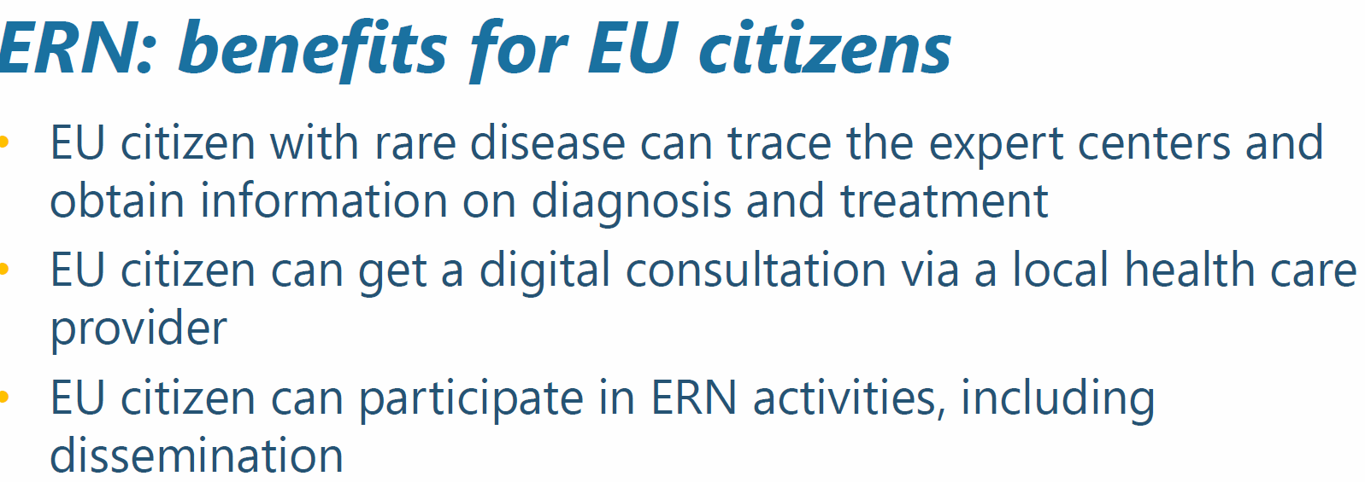

Slide 32
DIGITAL HEALTH

Slide 33
Digital health
Jas
Joint Action eHealth Governance Initiative [JA-EHGov]
Action eHAction
PJs

Slide 34
Digital health Joint Action eHealth Governance Initiative (JA-EHGov) Start date: 01/02/2011 / End date: 01/12/2014
Aim to support the eHealth Governance Initiative (eHGI) which functions as a platform for technical & political co-operation between Member States on eHealth including their relationship with eHealth Stakeholder Groups which include EU level organisations representing health professionals, hospitals, patients, standards developing organisations & industry
Results (recommendations, guidelines) have furthermore supported the work of the eHealth Network set up in accordance with Art.14 of the Directive on patients` rights in cross-border healthcare

Slide 35
eHealth / eHAction

Slide 36
eHealth / eHAction

Slide 37
Digital health / Future
Best Practices & Digital Strategy: Policies and best practices to prevent, control and manage NCDs across populations

Slide 38
ESF+

Slide 39
Further Information

Slide 40
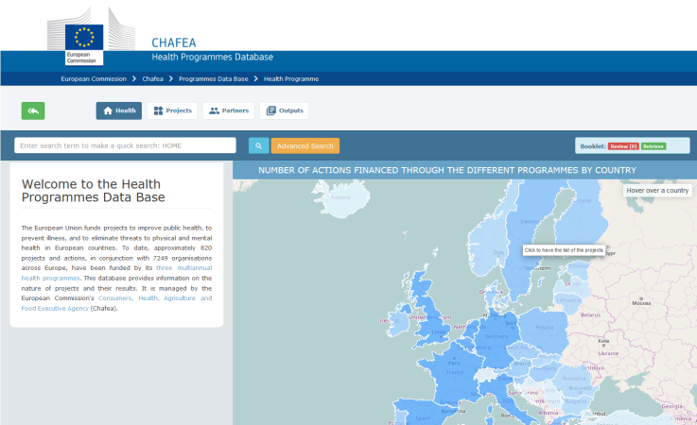
Useful links
Chafea Project Database (2003-2019):
https://webgate.ec.europa.eu/chafea_pdb/health/
European Commission Directorate-General for Health and Food Safety (SANTE) website
https://ec.europa.eu/health/home_en
Chafea Website
https://ec.europa.eu/chafea/health/index_en.htm

Slide 41
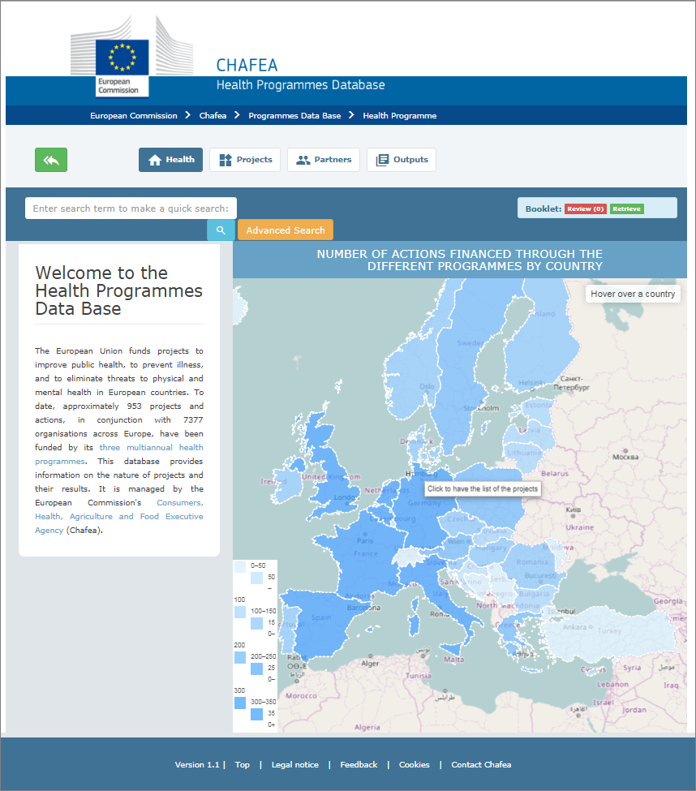
Project Database
Grants since 2003
1st, 2nd, 3rd Health Programme
Summary, Consortium, Public Deliverables
https://webgate.ec.europa.eu/chafea_pdb/health/

Slide 42
Further Information
Helpdesks:
CHAFEA-HP-CALLS@ec.europa.eu
CHAFEA-HP-TENDERS@ec.europa.eu
Chafea website:
http://ec.europa.eu/chafea/health/funding/index_en.htm
Publication of open Call for projects, including FAQ:
https://ec.europa.eu/info/funding-tenders/opportunities/portal/screen/programmes/3hp
Publication of open Call for tenders, including FAQ:
https://etendering.ted.europa.eu/general/page.html?name=home

Slide 43
National Focal Points
http://ec.europa.eu/chafea/health/national-focal-points/index_en.htm

Slide 44
Thank you for your attention!
Marc VANDENBROECK
Scientific Project Officer European Commission Consumers, Health, Agriculture and Food Executive Agency (Chafea) Health and Food Safety Unit

